Slide 1

Supervisor Assessment
João Henrique Linhares

Slide 2
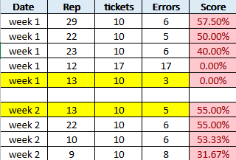
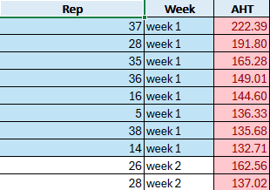
Quality

Slide 3
Personnel
Measurement
Motivation
Few Calibrations
Knowledge of the Policy
Late Measurements
Lack of Attention
Low Accuracy and High AHT
Noisy Ambient
Tooling Issue
Work-Station Position
Lack of Documents about the Policy
Environment
Material
Figure: The Ishikawa diagram for AHT and Accuracy pointing the possible root cause analysis

Slide 4
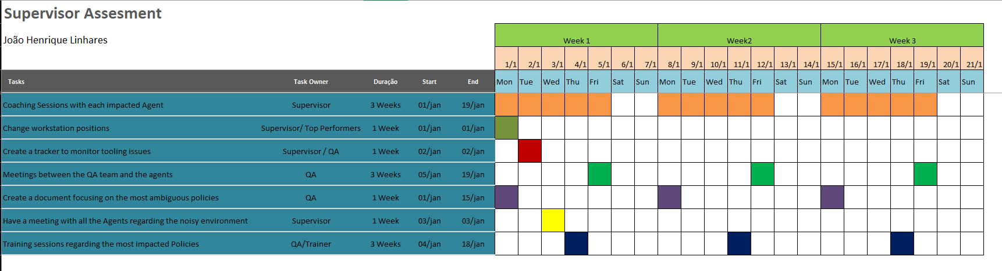
Based on the Ishikawa diagram, I came up with this action Plan

Slide 5
We expect a steady increase after the implementation of the action plan

Slide 6

Absenteeism Action Plan
Team A
Organize meetings with agents who are experiencing absenteeism issues. Investigate the causes and offer necessary assistance or resources. Address the issue of frequent medical leave requests and seek possible solutions or adjustments.
For agents without documentation, discuss with the first agent the reason for the absence and, if necessary, request that they submit the documentation as soon as possible. Otherwise, establish clear expectations to prevent this situation from recurring.
Regarding the second agent, demonstrate empathy for the situation and, if possible, develop a flexible schedule to accommodate the unexpected, minimizing the emotional impact on the agent.

Slide 7

Absenteeism Action Plan
Team B
Schedule individual meetings with the five agents facing absenteeism issues. Identify the reasons behind their study-related absences and explore options for flexible work schedules that accommodate their study hours. Establish clear expectations for agents to commit to attendance and maintain good performance, balancing work and studies effectively.
For the other agents, investigate the reasons for their frequent absences and, if possible, utilize the same strategy of flexible scheduling to address their medical needs. Encourage them to utilize company resources such as psychological support and emphasize the importance of attendance, highlighting the impact of absences not only on themselves but also on the entire team.

Slide 8

Adherence
Action Plan
Conduct a meeting with all agents to communicate that it is not permissible to take breaks and lunch simultaneously, emphasizing the importance of adhering to the workforce's predetermined alignment to improve team adherence. Set clear expectations for all agents to follow their schedules as displayed on the Mytp platform starting immediately.
Encourage agents to utilize their well-being time for restroom breaks, allowing them to return to their stations at the designated time and use their auxiliaries for any needs that may arise, thus not compromising their break and lunch schedules or production hours.

